Slide 1

Instrumentation and Control
CSE 325
Every man desires to live long, but no man wishes to be old
-Jonathan Swift
Mehedi Hasan
Lecturer
Computer Science and Engineering(CSE)
Daffodil International University(DIU)

Slide 2
Transducers
Transduction: The process of converting one form of energy into another.
Transducer: The device that performs this conversion.
Why Use Electrical Transducers?
Most real-world parameters are non-electrical (e.g., pressure, temperature, displacement, force). Electrical methods of measurement offer major advantages:
Better sensitivity, accuracy, and speed
Easier signal conditioning, amplification, and transmission
Electrical Transducer Definition
“A transducer is a device which, when actuated by energy in one form, produces an electrical output energy.”

Slide 3
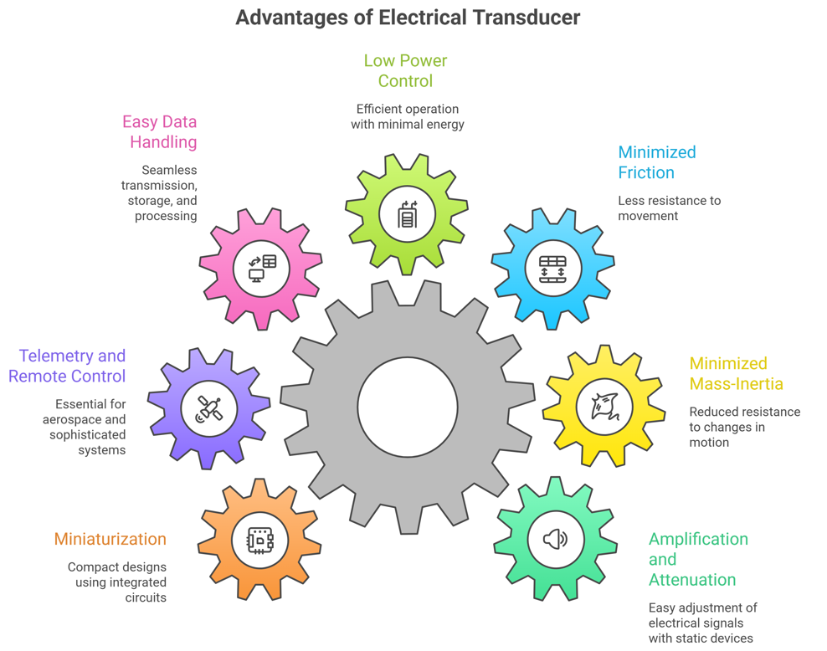
Advantages of Electrical Transducers

Slide 4
Classification of Transducers
A classification can be done based on the electrical circuit parameter that is meant to be changed due to the presence of the physical parameter to be measured:
1. Resistance
2. Capacitance
3. Inductance
4. Voltage and Current
Primary transducers
Transducers that sense a physical phenomenon at the first stage of detection; e.g. thermocouple
Secondary transducers
The physical phenomenon is first sensed by a non-electrical transducer. It’s output is then converted into an electrical signal by an electrical transducer. This second transducer is called secondary transducer.
For example: in one type of pressure meter, Stage 01: Bourdon Tube → Input: Pressure (non-electrical) and Output: Mechanical displacement
Stage 02: Secondary Transducer – Electrical Sensing → Input: Mechanical displacement from Bourdon tube and Output: Electrical signal (voltage, current, or digital)
.

Slide 5

Resistive Transducers
Transducer that employs change in resistance of a sensing element is called resistive transducer.
The well-known equation of resistance of a resistor element:
Design basis: vary any combination of the 3 quantities
For example: temperature can change ρ; strain can change L and A, altogether
Applications:
Temperature, strain, displacement, force, pressure etc.
Resistance Temperature Detector (RTD) Or Resistance Thermometer
An RTD is a passive temperature sensor that works on the principle that the electrical resistance of metals changes predictably with temperature.
Most metals exhibit a positive temperature coefficient (PTC) – resistance increases as temperature increases.

Slide 6
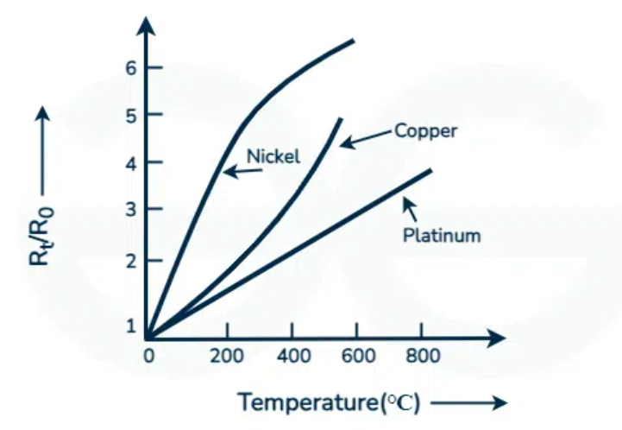
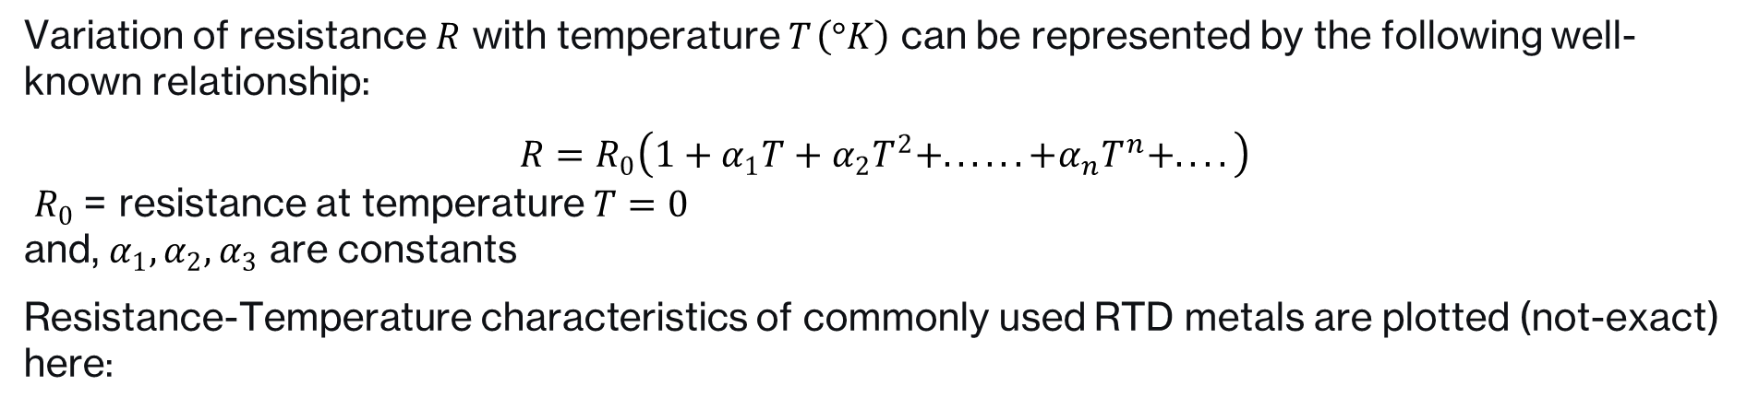
Resistance Temperature Detector (RTD)
Variation of resistance $R$ with temperature $T \left(°K\right)$ can be represented by the following well-known relationship:
$$R=R_{0}\left(1+α_{1}T+α_{2}T^{2}+......+α_{n}T^{n}+....\right)$$
$R_{0}$ = resistance at temperature $T=0$ and, $α_{1},α_{2},α_{3}$ are constants
Resistance-Temperature characteristics of commonly used RTD metals are plotted (not-exact) here:
The curve shows that the curves are nearly linear, or at least can be
approximated as linear for short temperature spans.

Slide 7
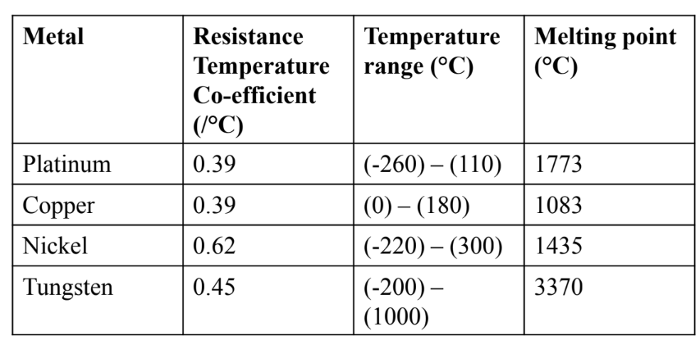
Resistance Temperature Detector (RTD)
Table: Metals used for RTD
Desirable characteristics of an RTD material:
Change in resistance per unit change in temperature should be as large as possible.
High resistivity, so that a minimum volume of material is used for the construction of RTD
The R versus T curve should be continuous, stable and repeatable.

Slide 8
Resistance Temperature Detector (RTD)
Material | Use in RTD | Key Characteristics | Application Notes
Platinum (Pt) | Widely used (PRTD) | High temp stability, noble metal, resistant to contamination, high accuracy | Best for precision measurement, industrial standard
Gold (Au) | Rarely used | Low resistivity, expensive | Not practical for RTDs
Silver (Ag) | Rarely used | Low resistivity, expensive | Not practical for RTDs
Tungsten (W) | Limited use | High resistivity, extremely brittle, difficult to work | Reserved for very high temperature applications
Copper (Cu) | Used as alternative | Low resistivity, good linearity, low cost | Requires longer element length; economical choice
Nickel & Nickel Alloys | Commonly used | Moderate resistivity, good sensitivity | Common in mid-range temperature applications

Slide 9
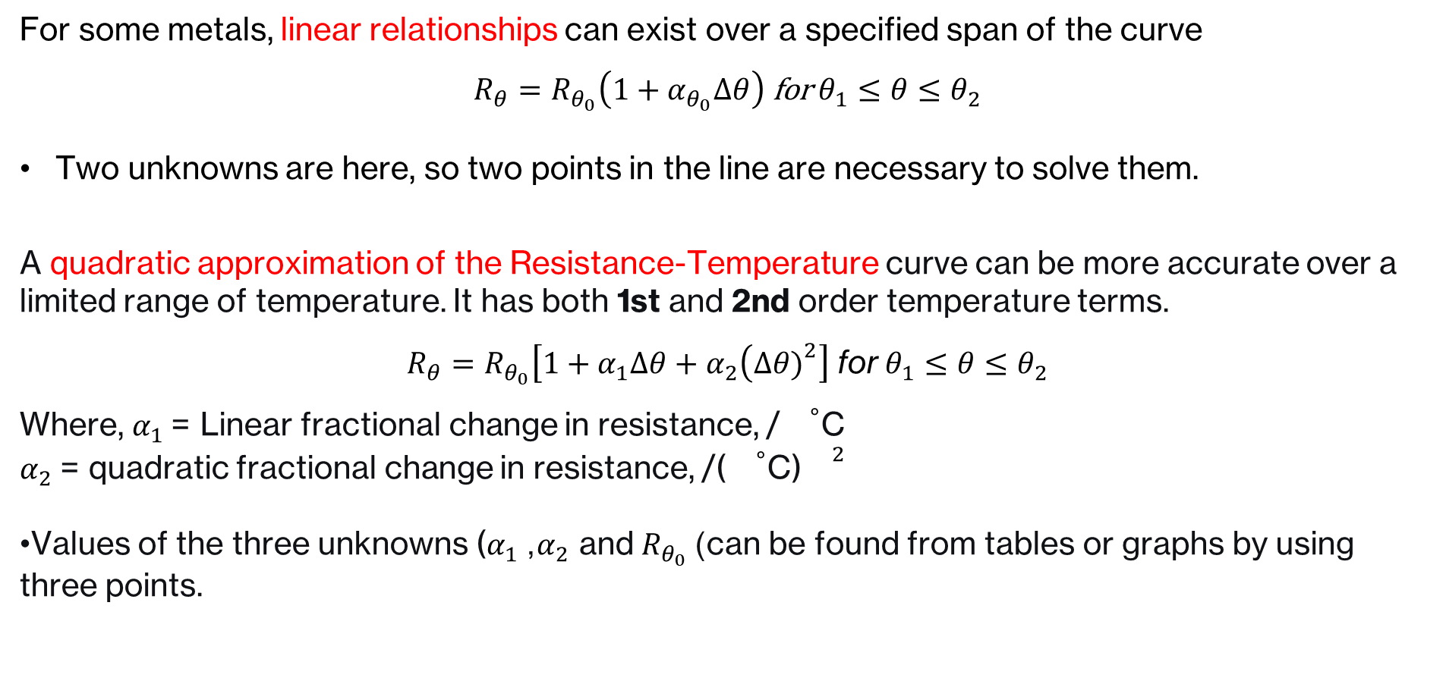
Equation: Linear Approximation
For some metals, linear relationships can exist over a specified span of the curve
$$R_{θ}=R_{θ_{0}}\left(1+α_{θ_{0}}Δθ\right) \text{for} θ_{1}≤θ≤θ_{2}$$
Two unknowns are here, so two points in the line are necessary to solve them.
A quadratic approximation of the Resistance-Temperature curve can be more accurate over a limited range of temperature. It has both 1st and 2nd order temperature terms.
$$R_{θ}=R_{θ_{0}}\left[1+α_{1}Δθ+α_{2}\left(Δθ{\left.)\right.}^{2}\right]\right. \text{for} θ_{1}≤θ≤θ_{2}$$
Where, $α_{1}$ = Linear fractional change in resistance, /${}^{∘}$C $α_{2}$ = quadratic fractional change in resistance, /(${}^{∘}$C)${}^{2}$
Values of the three unknowns ($α_{1}$, $α_{2}$ and $R_{θ_{0}}$) can be found from tables or graphs by using three points.

Slide 10
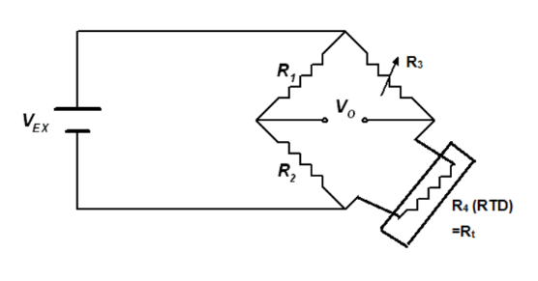

Measurement of RTD Resistance
Measurement Bridges are used for this purpose.
Wheatstone Bridge:
RTD is connected as one of the arms of the bridge.
So,
$$R_{t}=R_{3}\left(\frac{R_{2}}{R_{1}}\right)$$
Potentiometer $R_{3}$ can be calibrated in terms of temperature directly.

Slide 11
Applications
Why RTDs Are Used
RTDs are among the most accurate and precise temperature sensors.
Many industrial processes operate at high temperatures where extreme accuracy is not essential (e.g., ±2 °C error in a 250 °C process is acceptable).
Some applications, however, require very high precision — RTDs are preferred in these cases.
RTD Applications
1. Bioreactors
Requirement: Precise temperature control for growing biological cells.
Why RTD?: Small temperature deviations can kill cells or cause defective growth.
RTD provides: Repeated accuracy and stability for exact temperature regulation.
2. Low-Temperature Processes
Examples: Pharmaceutical storage, Chemical synthesis, Climate chambers
Requirement: Detecting small temperature changes reliably.
Why RTD? High sensitivity and repeatability at lower temperature ranges.

Slide 12
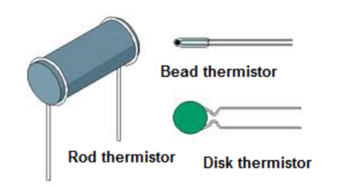
Thermistors
Contraction of the term, “thermal resistors”
Generally made of semiconductor materials
Have negative temperature co-efficients, i.e. resistance decreases with increase in temp (Due to production of higher number of electron-hole pair generation as temperature increases)
Sensitivity is high, so suitable for very small changes in temperature. This makes them useful for precision temperature measurement applications.
Relatively low cost and small size.
Measurement range: approximately, (-60) – (15) °C

Slide 13
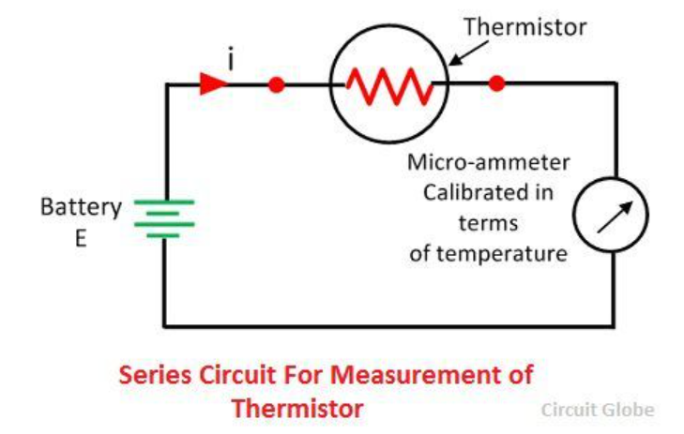
Measurement and Control of Temperature: Thermistors
High Sensitivity
Provides a large change in resistance for a small change in temperature.
Much higher sensitivity compared to RTDs and thermocouples.
Ideal for detecting small temperature variations.
Simple Circuit:
Thermistor resistance changes with temperature → current changes.
Micro-ammeter can be directly calibrated in temperature units (°C).
Simple, low-cost, but less precise.

Slide 14
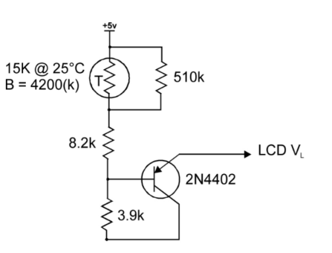
Thermistors : Applications
Temperature compensation:
Thermistors have negative temperature co-efficients, opposite to that of electrical resistors. So, they are widely used to compensate for the effects of temperature.
They are so connected in the circuit that the total circuit resistance is constant over a wide range of temperatures
Other Applications:
Measurement of flow, providing time delay etc.
Thermistors are versatile not only for sensing but also for actively compensating temperature effects in electronic systems.

